Slide 1

Java and You
Chad Michel

Slide 2
Java
1995
Sun Microsystems – Now owned Oracle
Object-oriented
Write once, run anywhere

Slide 3

Java Mascot
http://upload.wikimedia.org/wikipedia/commons/4/40/Wave.svg

Slide 4
JavaScript?
Isn’t that just the same thing?

Slide 5
JavaScript
Dynamically typed
Functional
“Assembly language of the web” – Scott Hanselman

Slide 6
JavaScript https://github.com/chadmichel/JavaScriptStuff

Slide 7
What we are going to cover
JavaScript
Best Practices
TDD
Single Page Applications
Node

Slide 8
JavaScript timeline
1999
Hated by all developers
2006
jQuery
JavaScript = OK
2009
Node.js
JavaScript = ?
1995
Created
2014
JavaScript = cool?
2008
Chrome V8
JavaScripts is now fast

Slide 9
JavaScript
Client side
Server side
Performance
Is there anything it can’t do?
Much like donuts

Slide 10
Wait a second
We spend more time doing client side work than anything
We can pound thru a backend super fast and on a schedule
Client side programming still kicks our butts
JavaScript is a major part of client side

Slide 11
JavaScript is a little weird
Weird isn’t always bad
First class functions in JavaScript are awesome

Slide 12
JavaScript variables are function scoped
var poop = "bye";
if (true) {
var poop = "hello";
}
alert(poop);

Slide 13
Odd comparison operators
== or ===

Slide 14
Be careful when adding numbers and strings

Slide 15
Best Practices

Slide 16
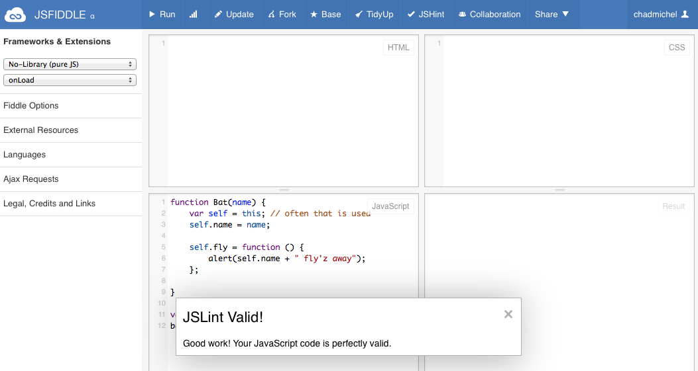
Use JSLint or JSHint
Do this…

Slide 17
Patterns
IIFE
Semicolons
Revealing Module
TypeScript class
Self/that

Slide 18
Use what a language does well
Minimize inheritance
Go more functional
Go dynamic

Slide 19
TypeScript or CoffeeScript
Assembly language of the web
Both of these provide things such as classes and inheritance
With newer browsers you can debug in native TypeScript or CoffeeScript

Slide 20
TDD

Slide 21
Test, test, test
Automated testing makes development faster
Automated testing makes development more enjoyable
Automated testing keeps you sane

Slide 22
Other frameworks
Jasmine
Mocha

Slide 23
Single Page Applications

Slide 24
SPA
Single page application
Kind of a big deal right now
Ask yourself do you really need a SPA
Use frameworks to minimize the pain

Slide 25
Angular
Client side SPA framework
Handles
Routing
Data binding
Testing
One framework for everything
Durandal – like Angular but built on other frameworks

Slide 26
Client side routing
Client side routing often uses a #
http://myhost.com/hello/world
Client side is often
http://myhost.com/#hello/world
With html5 pushState you don’t have to have #

Slide 27
Data binding
<div>
<div ng-repeat=“user in users”>
{{user.name}}
</div>
</div>

Slide 28
Routing
config(['$routeProvider', function($routeProvider) {
$routeProvider.when('/orders', {templateUrl: 'partials/orders.html', controller: 'OrdersCtrl'});
$routeProvider.when('/catalog', {templateUrl: 'partials/catalog.html', controller: ‘CatalogCtrl'});
$routeProvider.otherwise({redirectTo: '/catalog'});
}]);

Slide 29
Unit testing
Angular has a nice testing framework baked in
Angular supports both unit and end to end tests out of the box

Slide 30
Other frameworks
Backbone
http://backbonejs.org/
Durandal
http://durandaljs.com/

Slide 31
Smaller frameworks
Knockout – data binding
Sammy – routing+
Require – module loading

Slide 32
Node

Slide 33
JavaScript on the Server
sockets.io
Push notifications from the server
Low footprint
Fast
Very early

